Slide 1
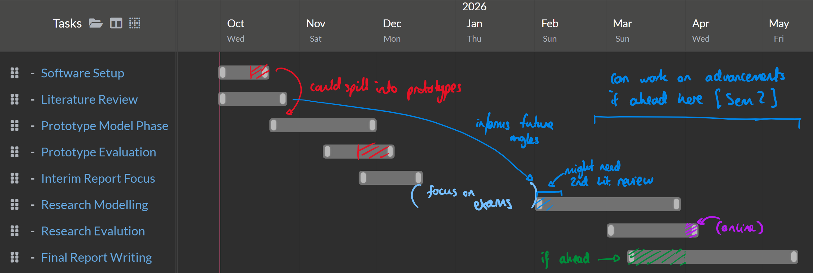
Rough Project Plan
Keeping the timelines rough, flexible, overlapping, Trying to leave room in case of spilling overtime
Only pencilling in advancements in the later stages of the project if time permits

Slide 2
Details into Phases
Software setup
Learning and setting up local builds of docker
Build local images of openMC environments
Optional: Setup a git repository for good source control ( + education )
Literature Review
Review general fusion motivations for breeding blankets, state of technology and main players / stakeholders, main types for breeding blankets
  ITER (big)
  China (check EAST etc. )
  US (Commonwealth Fusion, Liquid Lithium)
  UK (Oxford / Harwell Campus, Oxford Sigma (liquid lithium) )
Review of tritium breeding literature (critical)
Brief review of Software, MC, openMC developed by STFC (? How much detail )
Prototype Model Phase
Work towards basic "complete loop" model
Simple geometry, typical materials, focus on building reliable models
Modularise code and distribute packaged functions for these basic models (with function inputs ready for adjustments later on)
Prototype Evaluation Phase
Data analysis (TBR is the main goal)
Critical evaluation of results (attempts to check if physical)
Plan next research areas given the results
Plan areas of the model to iterate and develops
Research Modelling Phase
Depends on what we have time for
Parameter sweeps
  Sweeps of breeder blanket thickness (aided by good modularisation of code)
  Sweep enrichment of different materials (Lithium)
  Material Ratios (amount of lead)
Research into different materials (research on custom material properties)
Extension: Adjusting geometries
Research Evaluation Phase
Data analysis (TBR is the main goal)
Critical evaluation of results (attempts to check if physical)
Presentation of results for our simulations against different parameters / materials
Conclusions on findings for improving TBR ratios
Optional: Viability assessments of certain paths
Software outcomes and discussion of possible extensions
Extension: Further Software Developments
Only if time permits
Attempting training of surrogate model based on research data
Attempting RL model to automate and iterate optimum TBR given certain inputs.

